Slide 1
Bowen Family Systems Theory:
A Different Lens on Self, Social Work, and Families
Heartland Social Work Virtual Conference
March 8, 2024

Slide 2
KC Center for Family & Organizational Systems
Margaret Otto, LSCSW
Director
Senior Theoretical Consultant
motto@kcfamilysystems.org
kcfamilysystems.org
(816) 200-1638
‹#›
Notes:
Rosalind HF presentation summer 2011
‹#›

Slide 3
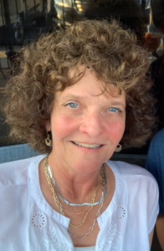
Margaret Otto, LSCSW received an undergraduate degree in Sociology from Bethany College, Bethany, West Virginia and a Master’s in Social Work from Washington University, St. Louis, Missouri. Her postgraduate education began at the Menninger Family Therapy training program. From there she trained at the Bowen Center for the Study of the Family where participation involved postgraduate seminars, research seminar and the National network. She has been studying and applying Bowen family systems theory for over 25 years which includes studying under Murray Bowen, MD and Michael Kerr, MD.
Margaret is clinically licensed in both Kansas and Missouri. Her career began as a non-medical professional in medicine. This included hospital, nursing home and home health settings where she was the Director of Social Services. From health care she moved into the community mental health arena and established a BFST full time private practice in 1988 which has continued until today. For four years she taught family practice residents about how families work at TMC.
In 1996 she co-founded and became the Director of the KC Center. Under her leadership, a federal grant was achieved as well as other programming. BFST was utilized to design the research on low-income unwed expectant or new parents. Margaret is a national and international presenter on families with particular interest in clinical applications and remissions, Recently she presented on Theories of Emotion at the International Conference on Bowen family systems theory in Sweden. She the carries local and national responsibility for the leadership of the KC Center and oversees the programming there which includes the Postgraduate Education & Training, annual conferences and the Webcast Series, She is on the Board of the Bowen Theory Academy.

Slide 4
MISSION
The KC Center for Family is a 501(c)3 organization dedicated to accurately representing, applying and expanding Bowen family systems theory in the regional area. The intent of the variation in programs offered is to be open to all interested individuals in learning to apply the theory to their personal and professional lives and assist in effectively managing the challenges they face individually, in their families, organizations and communities.

Slide 5
Questions for the audience….
Who has been taught BFST?
How many family psychiatrist do you know?
How do you know which which theoretical model a co-worker is coming from?
How many of you have been stressed by the relationships with your family or not?

Slide 6
Objectives
Describe the history of social work and families.
Describe two of the basic concepts of Bowen Family Systems Theory.
Describe Social Worker self-management with the clinical process.

Slide 7
Social Work & Families
Hull House, a settlement house, in 1889
Jane Adams and Ellen Starr co-founded this settlement to serve the social, artistic and educational needs of immigrant families. By 1920, there were 500 houses.

Slide 8
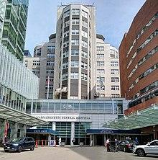
Medical Social Work & Families
Massachusetts General Hospital was the first to have professional social workers on site, in the early 1900s. A physician, Dr. Richard Cabot requested services for primarily failure to thrive patients. He had a treatment plan but no way for implementation. Ms. Ida B Canon was the first medical social worker and she began training others in 1912. Medical social workers did case management, data collection, follow ups, care coordination, health education, financial assessment and discounting patient medical fees.

Slide 9
Social Work & Families
Family Research: NIMH 1954-1959
The camelot of research at NIMH, Bethesda, MD with Dr Bowen in the lead. Bethesda, M.D. that lead to the discovery of the family as an emotional unit.
Families with an adult schizophrenic child living on a research ward for long periods of time. ( for ex 18 months)
A wealth of new facts and methods by watching the intense process in schizophrenic families…. these families had the “ right “ emotional process to be admitted to the unit. The dx was secondary.
As the project went on , staff and families attended the staff meeting and started to address their own part of the problems. This produced marked improvement of the family symptoms.
Focus and training medical staff on function not dx. For example, all dx terms eliminate and described instead. The term “ maximum disfunction” was used instead.

Slide 10
Social Work & Family Research
Mrs. Betty Basamania was the social worker on Dr. Bowen’s project along with two other psychiatrist. (10/1955-12/1958)
“ Since Mrs. Basamania was a social worker, she has studied and worked with the family…. Due to this background, she suggested the concept of the “ family unit.” The psychiatrists were immediately interested because it was appropriate to our ongoing observations. “ Researchers coming to the same understanding without telling the other.
“it was clear that all families were pretty much alike. I decided that my own family would provide as much detail and would be more accessible. That was the beginning of the multigenerational study of my own family. Murray Bowen, MD.
Rakow, C. M. (2022). Making Sense of Human Life. Taylor & Francis.. pg 190

Slide 11
Social Work & Families
So…. since the beginning of social work, social workers have been at the interface with families, their individual members and their communities. Just 3 examples of many.
Social work did not start with individual psychology.

Slide 12
Individual or Cause & Effect Thinking/Linear thinking
This is a default mode in the brain that becomes the primary way of thinking, particularly under stress.
Basis of medical model.
It is also the basis of blame. Blame the other or blame self. Two bad outcomes.
This is not a theory but a default position.
A B

Slide 13
OR … A Systems View:
Individual or Cause & Effect Thinking/Linear thinking
A B
Seeing the co-created process is the beginning shift to systems thinking. A move, counter move, an action and then a reaction.
This is the basic premise of starting to think systems which lead to family systems theory.

Slide 14
Basic Premise of Family Evaluation:
How you think about a problem determines how you approach it. For ex. cause and effect thinking or systems thinking are two different ways of thinking. Attachment theory or systems thinking are different, etc.
Systems thinking: The family impacts the individual, the individual impacts the family. Can not separate the context from the individual.
Different thinking creates different solutions.
This is the most important slide of the presentation!

Slide 15
What is a theory? How is it different than a technique?
A theory is a well-substantiated explanation of an aspect of the natural world that can incorporate laws, hypotheses and facts.
A theory is a description.
A technique is a skillful execution of a procedure, a particular way of achieving a task
They are not the same. Sometimes a theory leads to a technique, other times a technique is valued on its own.

Slide 16
WHAT IS A FAMILY?
Attachment to an emotional nucleus, behaving and being for the other.
Composed of multiple individual people & relationships
Fusion makes it a unit; emotional atmosphere of it can regulate the individual. Of course, the individuals contribute to the atmosphere. oneness

Slide 17
Assessment and evaluation
How does an individual get assessed …..
By thinking about the individual alone?
By thinking about the individual in context?
Are the family, social and work relationships important in assessment?
Is there a way to think about symptoms being part of the relationship dynamics?

Slide 18
First Basic Concept
FAMILY ONENESS
Theoretical section on family emotional oneness, followed by variation in functioning and finally applications to social work.

Slide 19
FAMILY AS ONE EMOTIONAL SYSTEM, WHICH MAKES IT A UNIT
Feed forward process with mutual participation: simple & very complex
Fusion of individual self’s, into one complicated unit
Predictable patterns of interaction in co-created processes
Moves beyond blame & cause and effect thinking
Possible to be objective about the emotional system? Describe the systems functions with objective and observable fact.
Notes:
Predictable pattern is attach & defend If one can get out, a calm position . Not having to attach the other, or defend position Simply stated
Possible to describe how the system functions with objective fact

Slide 20
FAMILY AS ONE EMOTIONAL UNIT
Families “feel for the other”, the other can also give them a “headache.”
Mutually affecting each other, shift in one creates a movement in the other
Hypersensitivities to the other, reaction to the action; attack defend; move counter attack… sometimes in a productive way, other times not so much.
Reciprocity is within a group and between groups
Levels of responsiveness varies among family units
The human family is an unit because it operates as a system…. The whole is greater than the sum of its part. It’s “the fit of the pieces, not the presence of the pieces.” MB
Humans care deeply for each other and are sensitive to each other’s expectations, attention, approval and distress. This creates a natural emotional interdependency the strength of which varies with each family.
The first person responds to another, who responds to a third person, who responds to the first person, etc. There is a pinging/ ricocheting off of each other that can develop a life of its own. This process can go further than anyone intended.
Notes:
Revision of Dan’s slide, and family eval. On pg 10

Slide 21
WHAT IS BOWEN FAMILY SYSTEM THEORY?
“ a theory of human behavior that views the family as an EMOTIONAL UNIT and uses systems thinking to describe the complex interactions in the unit.” Michael Kerr, MD
This is a natural systems theory. It is not based on the conceptualizations of the brain, like math for example. It is based on observations that lead to a scientific theory about human behavior.
Fusion makes it a unit; emotional atmosphere of it can regulate the individual. Of course, the individuals contribute to the atmosphere. oneness
Science of Human Behavior
Concepts that can be tested and developed through the observations of nature and the progress of concepts
Ideas testable, contrasted to other concepts and information from relevant fields gathered and incorporated
Notes:
A theory is simply a description.
A description of the way it is. It is a complex description of process. If it matches nature, it is a scientific theory and not one that is just conceptualized in the brain.
BFST is a natural systems theory about families & how they work.
QUOTE is from Michael Kerr, current leader of the Bowen Center for the Study of the family in DC.He replaced Dr. Bowen as the leader after Dr. Bowen’s death in 1990. Belief & work toward human behavior can become a science.
Dr. Bowen, a psychiatrist originally interested in surgery then shifted to psychiatry, developed the theory. He started to think about these ideas in the 1940s and began to actively research them in the 1950’s. He developed a theory that was compatible with the way the brain actually worked, not with what it could conceptualize. Dr. Kerr took over after his death in 1990.
Dr. Bob Noone

Slide 22
WHAT IS BOWEN FAMILY SYSTEM THEORY?
The theory has been expanded and developed since its inception.
Examples of areas of application: clergy, business, family business, all levels of social work, medicine, psychology. National and international sites and conferences.
Utilized also in the ED, EAP, nursing home, home heath,international relations,business, private practice and teaching family residents etc. etc.
Relationship disruption a variable in symptom development. This is often a major factor that goes unseen.

Slide 23
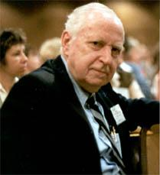
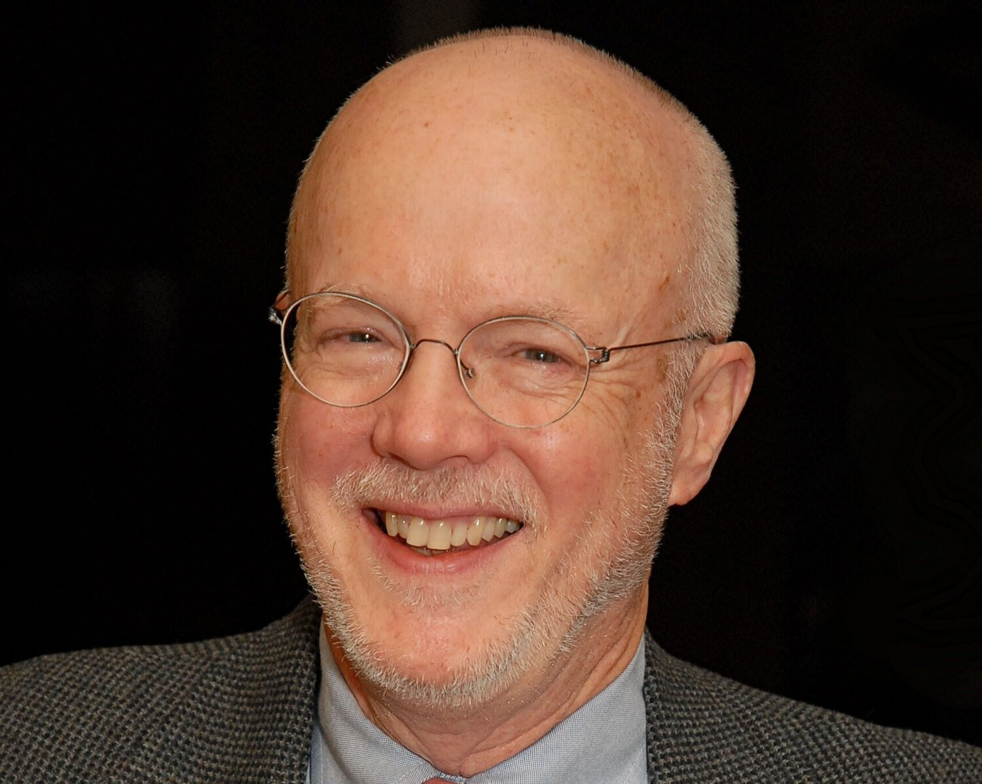
FAMILY AS ONE EMOTIONAL UNIT
Bowen Family Systems Theory
Discovered that the human family is an emotional unit or system. Murray Bowen, M.D. (1913-1990)
Michael Kerr, M.D. (1940- ) expanded upon theory

Slide 24
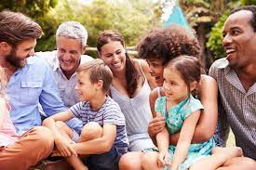
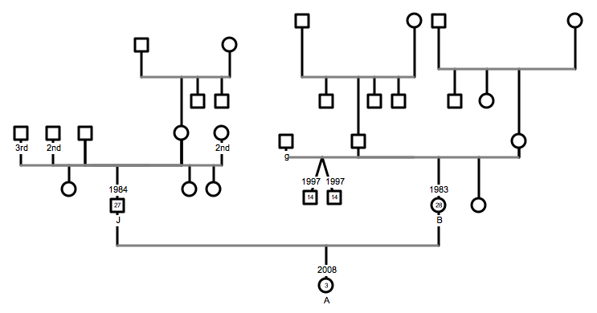
FAMILY ONENESS
The human family is one emotional unit or system ( vs. just the individual. or a collection of individuals.) Composed of fused reciprocal relationships Other human relationships were emotional systems too. (school systems, legal systems, biological systems)
24/90
Notes:
Revision of Dan’s slide

Slide 25
Comments & Questions

Slide 26
Second Basic Concept
VARIATION in Level of Differentiation
Assessment and evaluation

Slide 27
Variation of family functioning driven by fusion & resulting chronic anxiety

Slide 28
Circles and squares and triangles
How to read the descriptions:
Fusion is more overlapped for example this mother daughter pair
More independent emotional functioning is drawn as more separate:
Theoretical ideal
Like drawing the wind

Slide 29
Variation in Level of Differentiation
Immaturity Mature
Very interdependent More independent
Chaotic Orderly calm
Emotional Cut-off &/or chronic dependency Multiple family contacts that are easy & useful . and resourceful
Tension More relaxed
Low proximity Higher proximity
Higher chronic symptom load Lower chronic symptom load
Emotional reactivity dominates Thoughtful & personal goal directed behavior
Less likely couple co-parents More likely couple co-parents
All families fall on the continuum. Different branches of the family vary as well as each family.

Slide 30
Differences between families
Variation in Level of Differentiation
Vary in degree of maturity
High maturity: life events encountered & dealt with, not a “big deal”, deal with & move on without creating any grief
Mature systems are positive & relaxed, low maturity intense & negative; focus on the negative not the good (is part of regression)
Vary in degree of individual responsibility for functioning
Vary in degree to choose between thinking and feelings responses
Vary in degree of sensitivity and reactivity

Slide 31
Life pressures & maturity
Variation in Level of Differentiation
How life events are dealt with, many families deal with similar issues with a variation in responses. This variatie is determined by the level of differentiation. It is not one size fits all as would be implied by cause and effect thinking.
Vary in amount of goal directed behavior
Vary in ability to be a “self” or individuality
Vary in the systems pressure on the individual to give up self, people that love each other can unmercifully press on each other.
QUANTITY NOT QUALITY: Families deal with similar issues (conflict external stressors, wanting closeness while being allergic to it.) The amount of fusion, reactivity and emotional interdependence varies by the level of differentiation. All of us have a little schizophrenia in us.

Slide 32
Examples
Variation in Level of Differentiation
“ crudely put, the lowest maturity systems start with more symptoms, more stressors, a demanding emotional environment, and a multigenerational history of those same features.”
“Whether a system produces new stressors, new emotional burdens, or new opportunities.” James E Jones PHD
Notes:
James E Jones, PHD

Slide 33
Fusion and Anxiety
Variation in Level of Differentiation
“the other variable is the level of anxiety. The lower the level of self, the more reactive the person to anxiety.”
The more the emotional interdependence, the more the potential threat in the others response, the more the perception of threat
The family emotional system (behavior, sensitivities and mental processes of its members) changes with the amount of tension or anxiety in the system. Tension can come & go or it can become fixed and chronic
Notes:
Dan Papero, PHD off of his slide

Slide 34
Fusion and Chronic Anxiety
determined the level of differentiation
Variation in Level of Differentiation
“In an emotional field of sustained high anxiety, the over-all level of differentiation will move slowly toward greater undifferentiation.” (Bowen, p. 537)
“The lower the level of basic differentiation, the higher the average level of chronic anxiety.” (Kerr-Bowen, p. 115)
Notes:
Dan Papero slide

Slide 35
Variation in Level of Differentiation
What I think the theory says is that a person's basic level of differentiation of self, governs his vulnerability to emotional fusion in emotionally significant relationships.
The degree of fusion renders the relationship system more or less vulnerable to escalations of chronic anxiety and associated emotional reactivity.
Heightened and sustained reactivity renders the system more vulnerable to disruption. M Kerr, MD
Relationship disruption as a common denominator of symptoms

Slide 36
Connection and cut-off
Variation in Level of Differentiation
“All people have an emotional attachment to their parents that is more intense than most permit themselves to believe. At one extreme are those who continue to live within the parental emotional field. There are those who deny the attachment while living near the parents and who do more definite “cutoffs” from parents than others who live at a distance. At the other extreme are those who cut off from parents and leave home and never return nor communicate with them again.” Bowen 433

Slide 37
Levels of Differentiation of the family emotional unit can be seen in psychosocial evaluations.
Variation in Level of Differentiation
Large part of the family assessment process
For ex. Number of marriages, births, length of marriage, geographic location.
This information, if in a psychosocial evaluation, can trace the emotional and relationship system.
Knowable patterns, processes
Pattern in relationships
Functional facts trace emotional process

Slide 38
Where would you place the families that you work with on this continuum?
Variation in Level of Differentiation
Where would you place your own family on the continuum?

Slide 39
Families as a resource… or not
Variation in Level of Differentiation
Variables within unit
Increase ability to deal with stressors
Decrease ability to deal with stressors
39/90
Notes:
The level of tension & fusion in the group determines the amount it is a resource for the individual
If the group is calm, & the individual is presented with a challenge then the reality needs of the individual can be met with the group being a resource.
If the group is highly reactive to the individual, the challenge of dealing with the group is equal to, or more than the reality need.
Taxed & chronic strain in dealing with reality as more occur over time.

Slide 40
Comments and questions

Slide 41
Social work & families
Sooo…. I have covered the history of social workers and families, two of the basic concepts of the BFST and now on to the application of these ideas.

Slide 42
Social Workers have their own families
Individual and their families, work and social relationship systems have been and continue to be a fundamental focus of the social work profession.
Bowen family systems theory is a lens for viewing these dynamics. It applies to one’s own family as well as the individual, an integrated family member, that is being assessed and treated.
1960 “it was clear that all families were pretty much alike. I decided that my own family would provide as much detail and would be more accessible. That was the beginning of the multigenerational study of my own family.” Murray Bowen

Slide 43
A Social Worker and Her Husband
An example of emotional process between individuals; an example of a pattern of interaction

Slide 44
Social worker and her husband
Notes:
Story: two individuals
Nice couple next door. Looking quite functional & friendly. Give a brief example of anxiety running the show & the corresponding level of differentiation. No one in the family working up stream to define a position.

Slide 45
Social worker and her husband
Notes:
Both are same basic level of chronic anxiety .(add shading) In this moment, the wife is experiencing more exacerbation of the stress. Perhaps she has perceived a scowel from her boss, found out a family member ill,or been chewed on by her father. etc.
She has absorbed the anxiety & responding to it , gets twitchy. She is propelled by discomfort.

Slide 46
Social worker and her husband
Notes:
The anxiety is within now, absorped.she then moves towards her husband in a“needy & intense way, wanting the discomfort to go away. The anxiety then pulls towards her towards a togetherness move. Two basic life forces of togetherness and separateness that move relationships through push/pull interactions.

Slide 47
Social worker and her husband
Notes:
Now a sensitive & reactive couple. The husbands reactivity has increased & this couple is now a “hot couple”. He has sensed her tension & is fearful of it. Perhaps it will be expectations he can’t meet, or he will drowned in the togetherness. One of many anxiety driven responses.

Slide 48
Social worker and her husband
Notes:
A fight breaks out. Each is distancing & connecting through a fight. Each feeling threatened, reacting in an attach & defend mode.

Slide 49
Social worker and her husband
Notes:
The fight burns itself out.He then retreats to the basement with a drink in hand.

Slide 50
Social worker and her husband
The more the fusion in the family the poorer the development of self. The greater the anxiety, the more the fusion, the less the differentiation.
A fight might take weeks to recover from or it might not be made into a federal case and the couple goes on. This varies with level of fusion and anxiety.

Slide 51
Social worker and her husband
Notes:
Then they return in a few days, to a calmer state.The anxiety being less visible & looking like the nice couple next door.It is all there but less visible.
Top layer of anxiety that is easily visible is gone.

Slide 52
Social worker and her husband
Notes:
The more the fusion between the family members, the poorer the development of self. The thicker the lines between them, the least development of self, or self- definition . The greater the anxiety, the more the fusion, the less the differentiation. Each is guided by the other Anxiety & differentiation are interlocking variables. However, poor differentiation is as natural as greater differentiation. Both are wired into the body. This is related to the next slide as interlocking variable.
Fusion in relationship & fusion in the brain.

Slide 53
Now let’s add one more complexity
Complex relationship systems is the emotional environment clients and professionals live in.

Slide 54
Social Worker, Husband & Her Mother

Slide 55
Social Worker, Husband & Her Mother

Slide 56
More complexity:
Triangles are one concepts of families
Triangles carry the emotional process
Not pathological
Natural smallest molecule of relationships
Often benign, for ex. two sisters invite a friend to eat dinner
When anxiety and fusion are high it changes. The cornerstone drive triangles . A two against one phenomena can occur with two insiders and one outsider.

Slide 57
More complexity:
Nuclear Family Emotional Process
Nuclear family Emotional Processes is one of the 8 original concepts of BFST:
Marital Conflict - previous example
Child Focused - “my kids the problem”
Dysfunction in a spouse - “my husband is the sick one”
Distance in all - “heading to the movies or bar”
All four ways are adaptive and occur in all families. Some are used repeatedly or vary. This affects quality of life in the family.
Notes:
All 4 ways are adaptation by the fm/ not pathology
Occurs in every family
Impossible for all relationships to have equal tension-shifts & moves
Some methods used repeatedly, process returns to an automatic responsiveness .
Go thru the same fight; looking for the same response, return to the same well
Even if the well is dry.
Only a limited set of options
Tension leads to mechanisms leads to quality of life
What is function of each process & when is tension high enough & long enough it produces a sx?
Each a response to social pressure

Slide 58
How does a social worker think about effective self management in their field?
If this clinical example is the social workers family and there has been tension at home, how does the Social Worker think about professional and mature self management with the cases at work?

Slide 59
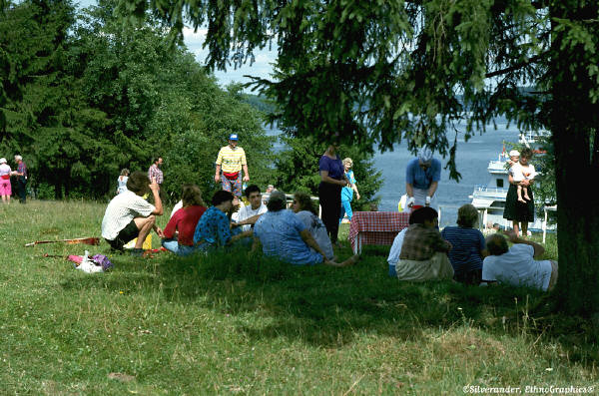
Does the social worker see SELF and the family? Each being different?
Social Worker’s family system

Slide 60
Family diagrams
The ultimate cheat sheet
-Useful in the ED
Not genograms

Slide 61
Social workers family
Social Worker Family

Slide 62
Separate/Together
Two different systems, two different histories, two different emotional processes interacting simultaneously.

Slide 63
BUT……. The emotional systems can leak and be projected onto the family. The family can project onto the social worker as well.
Client’s family diagram
How many know how to make a family diagram?

Slide 64
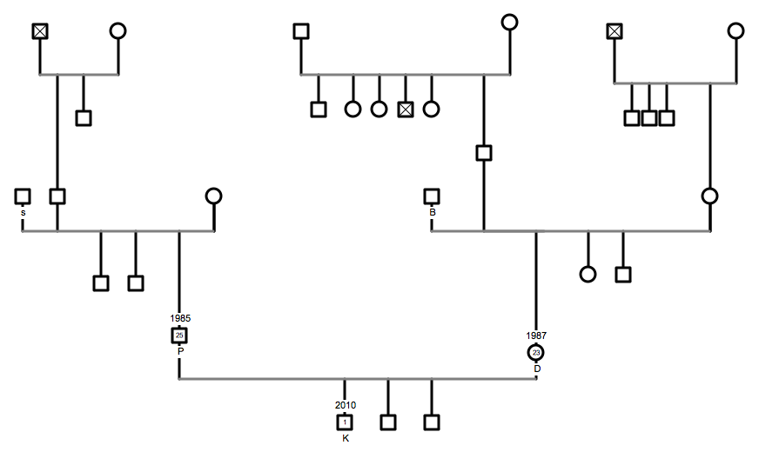
Client Family

Slide 65
Family Systems
Client Family System
Social Worker Family System

Slide 66
Family Systems: clinical work Two interacting systems or not??
Clinical Family
Social Worker Family

Slide 67
SEPARATE/TOGETHER
}
Separate
Beside
Counselor relating to the WHOLE Family UNIT and staying contained/ thoughtful and mature. Sure about what they can and can’t do for the family.

Slide 68
Social Worker Emotional Fusion
Social Worker agrees and joins the clients perspective
Social worker tired, more vulnerable to less neutrality.

Slide 69
However, Social worker is not aware of the emotional system in the clinical family and unintentionally aligns and participates their family system

Slide 70
How does the social worker get caught in the family projection process?….

Slide 71
The husband doesn’t want to talk to the social worker

Slide 72
Soo…. Accurate assessment and family evaluation of the individual means assessing the level of maturity/immaturity in the context of their relationship system as well as monitoring one’s own level of maturity/immaturity in context.
Being able to see it as a system creates a different lens.

Slide 73
Comments and questions
73/90

Slide 74
Research application for Bowen Systems Thinking
Grant example of low income, first time unwed parents

Slide 75
Variation Families & Parenting of single low income first time mothers

Slide 76
June 2006
Neighbor agency (Healthy Families) asked KC Center to participate in a Healthy Marriage Demonstration Grant. Told 3% chance. Grant is through Office of Planning, Research & Evaluation, Administration for Children and Families(ACF), US Dept of health & Human Services launched Building Strong families (BSF) project.
Serve Low-Income Unwed Expectant or New Parents and provide them with assessment & evaluation, marriage education, & family support services. Impact of the targeted approach on measures such as relationship stability and quality, and child well-being measures. ( encouraged marriage)

Slide 77
KC Center’s role
“ the KC Center will provide the following services to the project….
1. Staff Training of Healthy Family staff
2. Family Evaluations that falls under assessment
3. Couple Evaluations
Within a year, staff education was eliminated, the grant money cut in half, and couple evaluations never materialized. One year follow-ups were added

Slide 78
Family Evaluations 2007
Results: 100 family evaluations from staff interviews, realized 1,000 or more pieces of information
10% annual FU
Interview Guide evolved into an access table to accumulate the descriptive data of multiple cases.
Access table was developed with generally low numbers representing low functioning
Current sample (n=50)
Interview done by staff & faculty

Slide 80
Thinking about results
Young mothers at risk: higher rate of 15-20 year olds…..where is the father guarding in their family of origin? Perhaps look at those young mothers and see how many have biological fathers in the home
Risk of above average age spread….those that fall outside the means are at greater risk if combined with other risk factors

Slide 81
EMOTIONAL CUTOFF
1) (severe) no parent contact, little sibling contact, no grandparent contact
2) ( major) contact with on parent, some siblings, and no grandparents
3) (below average) contact with primarily one parent, some siblings, limited contact with one set of grandparents
4)(average) contact with both parents, some siblings, one set of grandparents
5)(good) contact with both parents, all siblings, both sets of grandparents

Slide 82
Fathers at greater risk of cutoff (27 below average or lower out of 40 that information was available)
About the same for the mothers (28) but most were in the below average category instead of lower categories

Slide 83
Mothers Birth Order

Slide 84
Fathers Birth Order
One Year Follow-Up

Slide 85
Only children paired with only children more than the national average.

Slide 86
BFST can lead to a family evaluations that can provide effective assessment in different setting.
This assessment than can contribute to effective program development and treatment.
It’s a different lens to the field of social work.

Slide 87
Nothing better than social workers!
My contact information again if interested in more about the post graduate program, webcasts, etc.
References
motto@kcfamilysystems.org
816-200-1638

Slide 88
KC Center Webcast Series
The dates for the 2024-2025 WEBCAST LECTURE SERIES are:
Date: September 27, October 25, January 3, January 24, February 28, March 28, April 25, May 30
Time: 12:30 pm-2:00 pm
Semester fees: $25 per individual session
CEU'S: 1.5 NASW approved CEU’s are available for each session

Slide 89
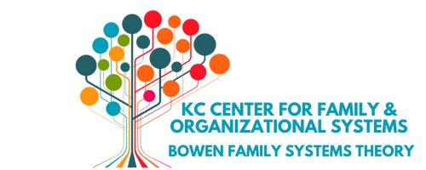
2024– 2025 Postgraduate Education
and Training Series
2024-25 Program Dates: The third Friday of the month.
2024: 9/20, 10/18, 11/15, 12/20 2025: 1/17, 2/21, 3/21, 4/18, 5/16
Time: 9:00 am-4:00 pm CST
2023-2024 Presenters: Dr. Jim Edd Jones; Stephanie Ferrara, MSW; Dr. Cheryl Lester; Randall T. Frost, MDiv,, Carolyn Jacobs, PhD., Kathleen Kerr, MSN, MA, CNS, Margaret Otto, LSCSW, Joan Jurkowski, M.S., LCPC
Contact: info@kcfamilysystems.org

Slide 90
References
Bowen, M. (1978). Family therapy in clinical practice. Rowman & Littlefield ; Northvale, N.J.
Kerr, M. E. (2019). Bowen theory’s secrets : revealing the hidden life of families. W.W. Norton & Company.
Rakow, C. M. (2022). Making Sense of Human Life. Taylor & Francis.

