Slide 1
Women and ADHD
Lara L. Ashbaugh, MS, LPC, NCC

Slide 2
Learning Objectives
Understand the difference in symptom presentation between men and women
Understand the social differences in diagnosis
Learn 3 behavioral techniques to cope with symptoms

Slide 3
A Word of Caution
Careful of self diagnosis
Not “boy” or “girl” ADHD
More needs to be understood about nonbinary

Slide 4
What is ADHD?
Attention Deficit Hyperactivity Disorder
Symptoms Fall Into 2 categories
Extremely high levels of inattentive/distractible/forgetful behaviors
Extremely high levels of acting before thinking about the consequences of the action
Or Both

Slide 5
The misnomer of ‘attention’
“Attention Deficit” – implies a person can’t pay attention
In ADHD is a fundamental difficulty in REGULATING attention as the demands of a given task, project, or situation shift

Slide 6
Hyper focus
An intense fixation on an interest or activity for an extended period of time
Often time blocking out the world around them
Neither inherently good or bad – it depends on the context and needs

Slide 7
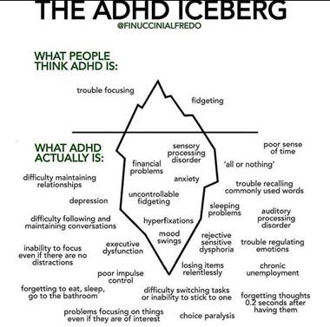

Slide 8
Prevalence
6.1 million children in the US (9.4%) between the ages of 2 – 17 have ever been diagnosed with ADHD
Boys are more likely to receive an ADHD diagnosis
12.9% vs. 5.6%

Slide 9
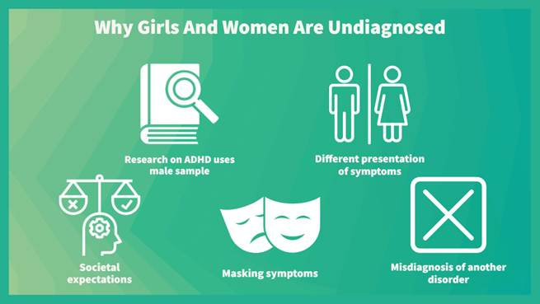

Slide 10
Gender Differences in ADHD

Slide 11
Predominant Symptoms
Men/boys tend to be diagnosed with more hyperactive/impulsive symptoms
Fidgety, always on the go, disruptive, restless, impulsive, impatient
Women/girls tend to be diagnosed with more inattentive symptoms
Harder to focus, pay attention to details, stay organized, listen, and remember things

Slide 12
Differences in Symptom Presentation
Hyperactivity
Internal vs. external
Verbal vs. physical

Slide 13
Predominant symptoms for girls: Inattentive Behaviors
Fails to give close attention – makes careless mistakes
Appears to not be listening
Difficulty with organization
Loses things easily
Easily distracted – forgetful in daily activities
Daydreaming
Poor time management or planning

Slide 14
Gender Norms
Masking
Societal Expectations
Symptoms seen as a character flaw
People Pleasing

Slide 15
Time Blindness
Inability to sense the passing of time
Over or under estimating how much time has passed
Not knowing how long a task will take
Not knowing which of 2 activities will take (or did take) the longest

Slide 17
Rejection Sensitive Dysphoria
Extreme emotional sensitivity and pain triggered by the perception that a person has been rejected or criticized

Slide 18
Shift in Treatment
Neuroscience advances
Positive Psychology
Recovery and Strengths based
Movement from
Medical Model “What is wrong with you”
To
Trauma Informed Care “What happened to you”
To
Resilience/Strength Based “What is right with you”

Slide 19
People are not broken
The goal isn’t to ‘fix’ them to be like everyone else
It’s about understanding how THEY function – and working within that to live the life they want

Slide 20
Coping Skills
Use timers to build in stopping points
Turn off notifications
Block time to complete tasks
Color Coding
INCUP
Interest, Novelty, Challenge, urgency, and passion
Exercise

